Slide 1
Introduction to IP version v4 and v6
Notes:
These slides were prepared in January, 2001.

Slide 2
Layer 3 - IP datagram
Version = 4
If no options, IHL = 5
Source and Destination are 32-bit IP addresses
Protocol = 6 means data portion contains a TCP segment. Protocol = 17 means UDP.
Version
IHL
Type of Service
Total Length
Identification
Flags
Fragment Offset
Time to Live
Protocol
Header Checksum
Source Address
Destination Address
Options
Padding
Data

Slide 3
Layer 3 - IP datagram
0 31
Version (4) |  | HLEN (4) |  | Types of services (8) |  | Datagram Length (16)
Identifier (16) |  |  |  |  |  | Flags (3) |  | Fragment Offset (13)
TTL (8) |  |  |  | Protocol (8) |  | Header Checksum (16)
Source IP address (32)
Destination IP address (32)
Options or Padding not always
Data (variable)
20 bytes header
* Number in bracket indicates bits used in that field.

Slide 4
Layer 3 - IP datagram
Version: Identifies the version of IP in use. Current version is IPV4.
HLEN: Header length is set to a value to indicate the length of datagram
header. Most IP datagram doesn‘t contain options, so HLEN mostly
indicates where the data begins in datagram. Typical IP datagram has
20 bytes header.
Types of services: Identifies different types of services included in
IP datagram such as delay, throughput, precedence etc. IP datagram can
be real-time or non-real-time as per type of services
Datagram Length: Indicates total length (Data + Header) of the IP
datagram. Maximum length if IP datagram is 2¹⁶=65535 bytes but
in general not more than 1500 bytes.

Slide 5
Layer 3 - IP datagram
Identifiers / Flags / Fragment Offset: Identifier (also called
Fragment ID) indicates all fragments that belong together. Flags indicate
that other fragments to follow. All fragments except last is indicated as 1
and last flag is 0. Fragment offset is used to tell the receiving host how to
reassemble the packets.
Time-to-Live (TTL): TTL is used to measure the time a datagram has
been in internet. Each Gateway in internet checks this field and discards
packet if TTL is 0.
Protocol: this field is used to indicate upper layer protocols (Transport layer)
that are to receive the datagram at the destination host. Either TCP or UDP
receive the IP datagram at destination.
Header Checksum: Used o detect bit error at the receiving datagram.
Source/Destination address: IP datagram used two 32-bits addresses called
source IP address and Destination IP address.

Slide 6
Layer 3 - IP datagram
Options: The option field is not used in every datagram. His field is used
sometimes for network management and diagnostics.
Data: Data field contains the user data. IP stipulates that the combination
of header and Data can‘t exceed 65535 bytes. Data length varies from
Protocol to protocol used in network access layer.

Slide 7
Introduction of IP v6 Addressing

Slide 8
Why IP v4 sustained yet
IP v4 sustained yet due to following concept:
Subnetting
CIDR
  Aligns routing table size with needs-based address allocation policy. Additional enforced aggregation actually lowered routing table growth rate to linear for a few years.
NAT
  Hides many nodes behind limited set of public addresses.

Slide 9
Why is a larger address space needed?
Overall Internet is still growing its user base ( IOT)
  ~320 million users in 2000 : ~550 million users by 2005
Users expanding their connected device count
  405 million mobile phones in 2000, over 1 billion by 2005
  UMTS Release 5 is Internet Mobility, ~ 300M new Internet connected
  ~1 Billion cars in 2010
  15% likely to use GPS and locality based Yellow Page services
  Billions of new Internet appliances for Home users
  Always-On ; Consumer simplicity required
Emerging population/geopolitical & economic drivers
  MIT, Xerox, & Apple each have more address space than all of China
  Moving to an e-Economy requires Global Internet accessibility

Slide 10
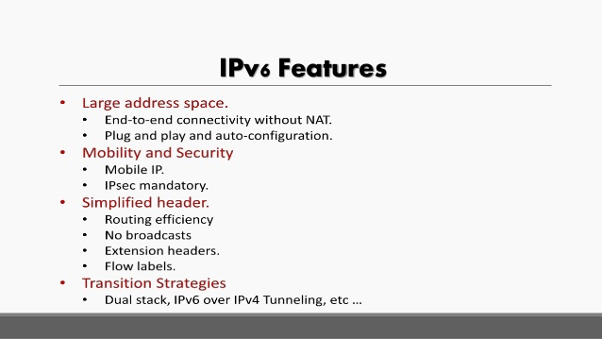
IPV6 Features:
No Checksum
IPSEC mandatory for
IPV6

Slide 11
Why Was 128 Bits Chosen as the IPv6 Address Size?
Settled on fixed-length, 128-bit addresses
  (340,282,366,920,938,463,463,374,607,431,768,211,456 in all!)
  Every grains of this universe can be addressed .
  IP v6 is represented in hex format
Notes:
“IPng” stands for IP Next Generation, and was the working name for the new IP in the early phase of its development.

Slide 12
Benefits of 128 bit Addresses
Room for many levels of structured hierarchy and routing aggregation
Easy address auto-configuration
Easier address management and delegation than IPv4
Ability to deploy end-to-end IPsec
(NATs removed as unnecessary)
Notes:
IPsec = the IP-layer security protocols, ESP (Encapsulating Security Payload) and AH (Authentication Header), which are defined for both IPv4 and IPv6. These protocols allow receivers to detect and discard packets that have been modified in transit, e.g., by bad guys or by transmission errors. Unfortunately, NATs work by modifying packets in transit…

Slide 13
Benefits of IP v6
Chance to eliminate some complexity in IP header
  improve per-hop processing
Chance to upgrade functionality
  multicast, QoS, mobility
Chance to include new features
  binding updates

Slide 14
Summary of Main IPv6 Benefits
Expanded addressing capabilities
Structured hierarchy to manage routing table growth
Serverless autoconfiguration and reconfiguration
Streamlined header format and flow identification
Improved support for options / extensions
Notes:
Note that Quality of Service is not one of the benefits of IPv6 over IPv4, despite what you may have heard. Both versions of IP have exactly the same QoS features defined. The only difference is the presence of the Flow Label field in IPv6, which allows more efficient packet classification by routers, but this is really a minor implementation optimization, rather than a significant new QoS feature.

Slide 15
IPv6 Advanced Features
Source address selection
Mobility - More efficient and robust mechanisms
Security - Built-in, strong IP-layer encryption and authentication
Quality of Service
Privacy Extensions for Stateless Address Autoconfiguration (RFC 3041)

Slide 16
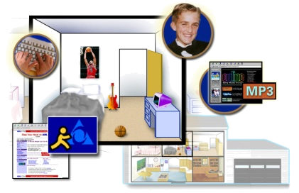
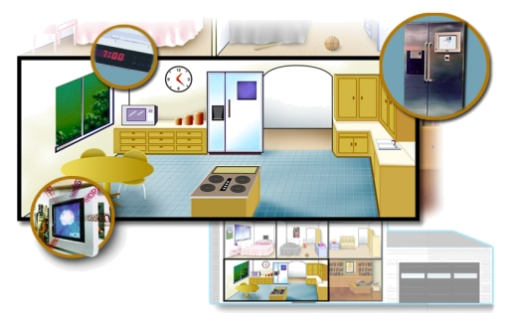







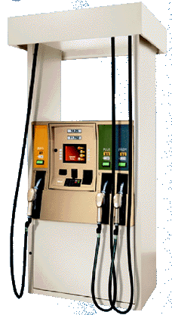
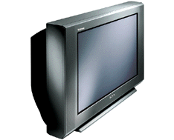
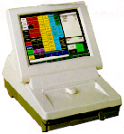


IPv6 Markets
Home Networking
  Set-top box/Cable/xDSL/Ether@Home
  Residential Voice over IP gateway
Gaming (10B$ market)
  Sony, Sega, Nintendo, Microsoft
Mobile devices
Consumer PC
Consumer Devices
  Sony (Mar/01 - …energetically introducing IPv6 technology into hardware products …)
Enterprise PC
Service Providers
  Regional ISP, Carriers, Mobile ISP, and Greenfield ISP’s

Slide 17
IPv6 Markets
Academic
Geographies & Politics:
  Prime Minister of Japan called for IPv6 (taxes reduction)
  EEC summit PR advertised IPv6 as the way to go for Europe
  China Vice minister of MII deploying IPv6 with the intent to take a leadership position and create a market force
Wireless (PDA, Mobile, Car,...):
  Multiple phases before deployment
  RFP -> Integration -> trial -> commercial
  Requires ‘client devices’, eg. IPv6 handset ?

Slide 18
The IPv6 Header : 40 Octets, 8 fields
0
4
12
16
24
31
Version
Class
Flow Label
Payload Length
Next Header
Hop Limit
128 bit Source Address
128 bit Destination Address

Slide 19
The IPv4 Header :
20 octets + options : 13 fields, including 3 flag bits
0
4
8
16
24
31
Ver
IHL
Service Type
Total Length
Identifier
Flags
Fragment Offset
Time to Live
Protocol
Header Checksum
32 bit Source Address
32 bit Destination Address
Options and Padding
shaded fields are absent from IPv6 header

Slide 20
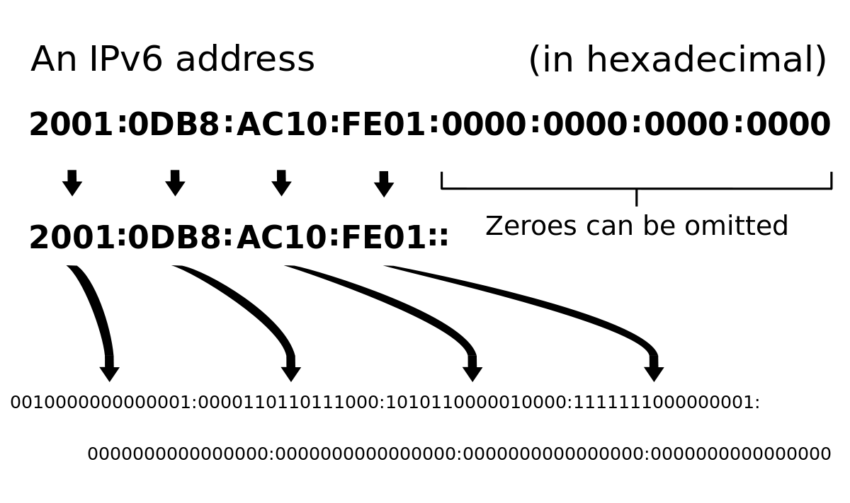
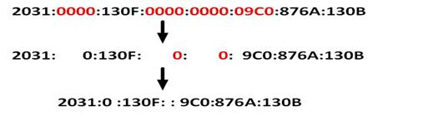
Text Representation of Addresses

Slide 21
Text Representation of Addresses

Slide 22
Representation of IP v6 Addresses
“Preferred” form: 1080:0:FF:0:8:800:200C:417A
Compressed form: FF01:0:0:0:0:0:0:43
becomes FF01::43
IPv4-compatible: 0:0:0:0:0:0:13.1.68.3
or ::13.1.68.3
IP Can be written in Uppercase or lower case

Slide 23
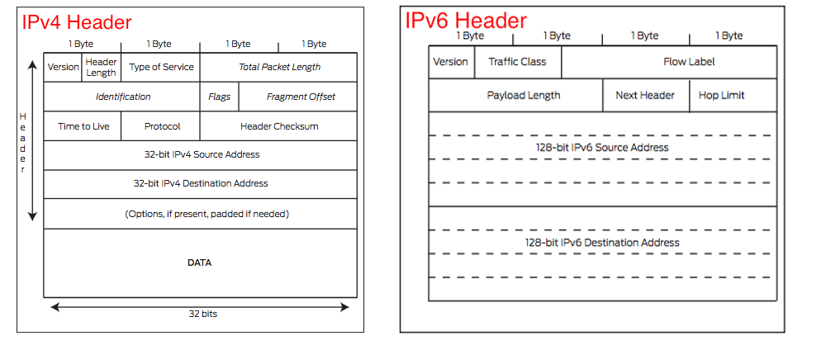
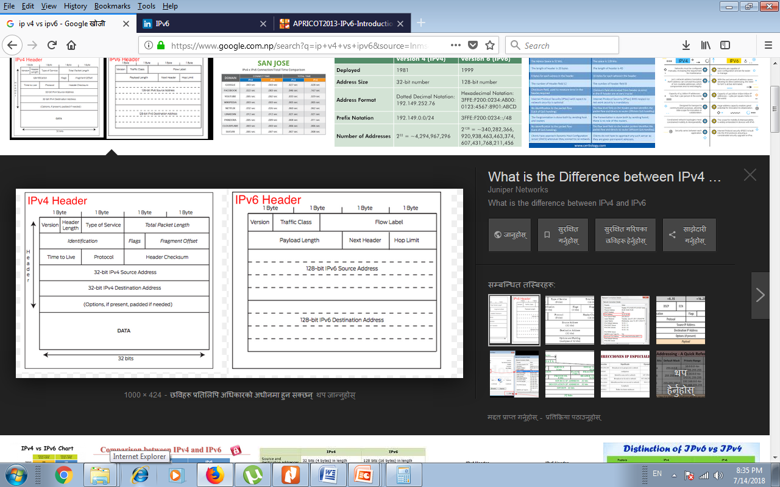
IP v4 vs IP v6

Slide 24
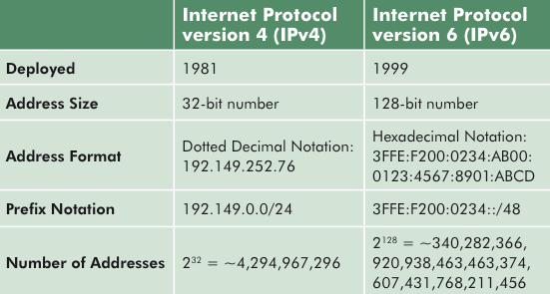
IP v4 vs IP v6

Slide 25
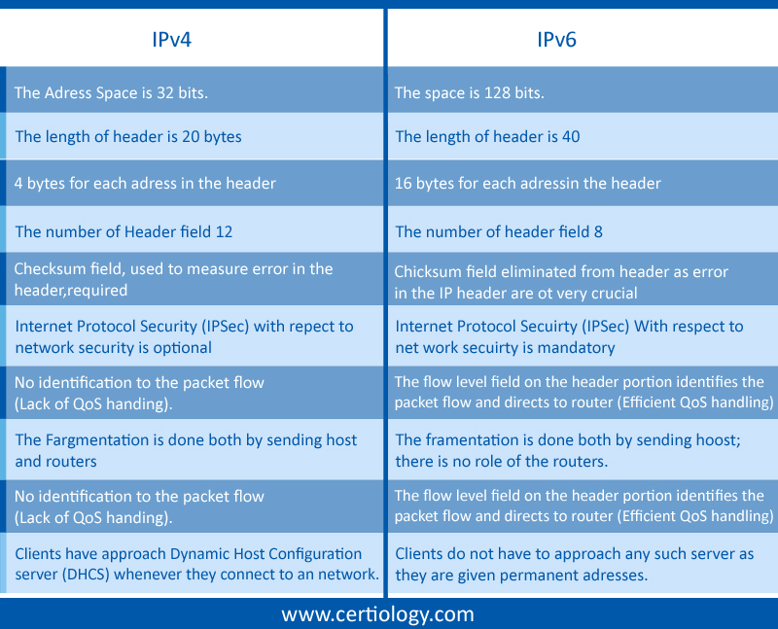
IP v4 vs IP v6

Slide 26
Types of IPv6 Addresses
Unicast
  Address of a single interface
  Delivery to single interface
Multicast
  Address of a set of interfaces
  Delivery to all interfaces in the set
Anycast
  Address of a set of interfaces
  Delivery to a single interface in the set
No more broadcast addresses

Slide 27
Some Special-Purpose Unicast Addresses
The unspecified address, used as a placeholder when no address is available:
0:0:0:0:0:0:0:0
The loopback address, for sending packets to self:
0:0:0:0:0:0:0:1

Slide 28





Questions?
2213
1313_06_2000_c2
© 2000, Cisco Systems, Inc.

